Slide 1
Maze Problem

Slide 2

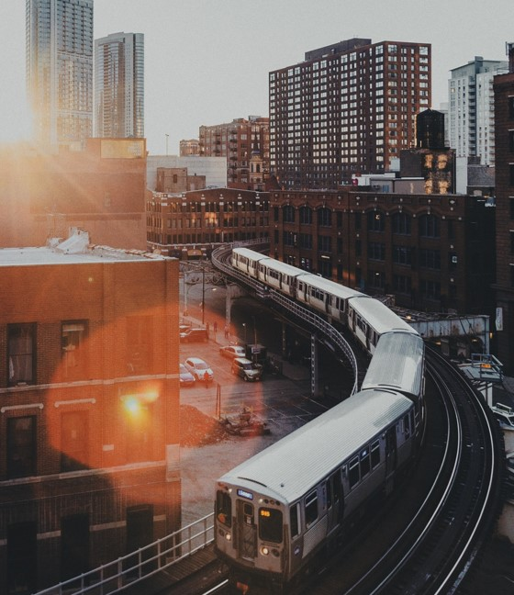
AGENDA
Maze Problem
Algorthim to solve problem
Algorithms steps
Conclusion

Slide 3
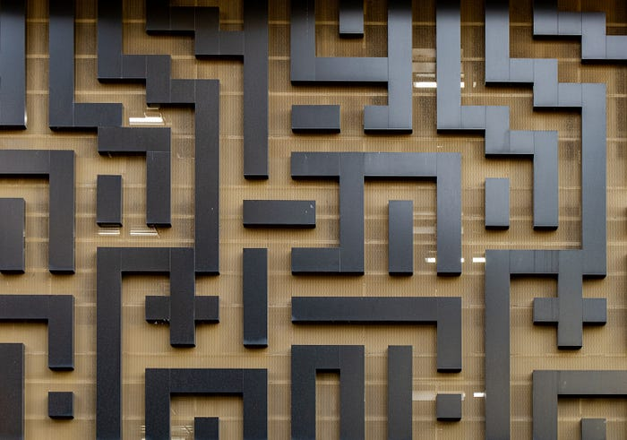
What is the Maze
a maze is generally represented as a 2D array or matrix consisting of rows and columns. Each cell is a intersection of a particular row and column and it represents a location in the grid. The cells in the grid may be open for traversal or may be blocked by an obstacle. If a cell is blocked by an obstacle that cell cannot be visited.

Slide 4
ALGORITHM TO SOLVE PROBLEM

Slide 5
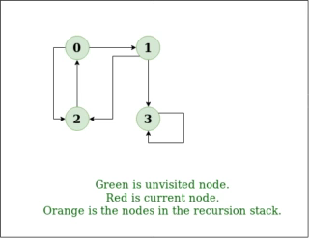
Depth First Search
Depth-First Search (DFS):- DFS is generally used to traverse the maze and to explore various paths. This algorithm is basically used in all of the grid/maze problems because in every problem we have to traverse the grid

Slide 6

Depth First Search algorithms steps
1. Call DFS on Node 1, mark it as visited, and check adjacency list.
2. Move to Node 2, mark it as visited, and call DFS.
3. Explore Node 0, mark it as visited, and attempt deeper DFS.
4. Backtrack from Node 0 to Node 2 due to no further paths.
5. Evaluate Node 3, mark as visited, and continue DFS.
6. Upon reaching Node 6, the target is found, ending the search.
7. Trace and print the path from Node 6 back to Node 1 using the call stack.

Slide 7

Conclusion
DFS is an ideal choice for solving maze problems due to its comprehensive exploration capability, memory efficiency, simplicity of implementation, and suitability for finding solutions in complex and deep path structures. While it may not always find the shortest path, its strengths make it a robust and reliable algorithm for general maze-solving tasks

Slide 8

THANK YOU

